Slide 1
FE Project #3
PowerPoint Report
Josh Bevan
3/27/12

Slide 2
FE Project #3
In FE Project #3 a long, slender, constant cross section steel cantilever box beam was examined under three different loading conditions. Maximum stress in each case was calculated using a finite element model as well as analytical solutions. There was excellent agreement between the two solution methods validating the results.

Slide 3
Parameter Generation
Student ID Digit # | 3 | 4 | 5 | 6 | 7 | 8
Variable | a | b | c | t₁ | t₂ | L_{mult}
Actual ID Digit | 2 | 7 | 4 | 0 | 9 | 6
Table 1: Variable seed values
A (Internal Box Web Height) | 0.2 m
B (Internal Box Flange Width) | 0.63 m
t₁ (Flange Thickness) | 0.01 m
t₂ (Web Thickness) | 0.009 m
L (Beam Length) | 38.88 m
Δl (Axial Tip Displacement) | 7.776 x10⁻³ m
v (Bending Tip Deflection) | 0.175 m
Φ (Torsion Angle of Twist) | 2°
Table 2: Generated beam parameters and load condition deflections

Slide 4
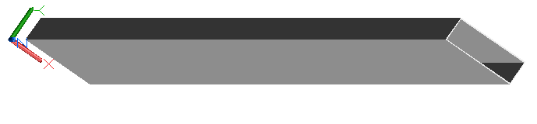
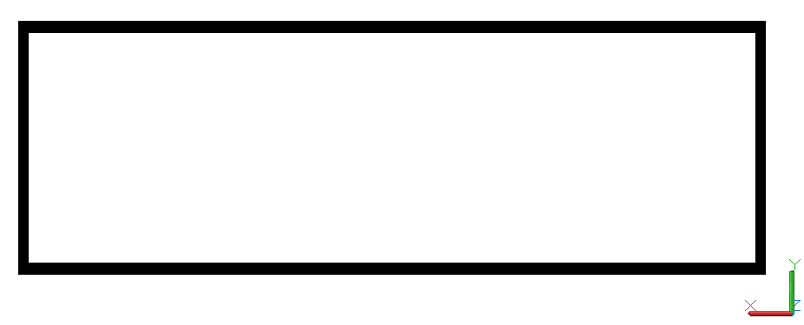

Sketch of Geometry
Figure 1: Box Beam – Isometric View
0.009 m
0.01 m
0.2 m
0.63 m
Figure 2: Box Beam – End View
38.88 m
Figure 3: Box Beam – Side View
0.648 m

Slide 5
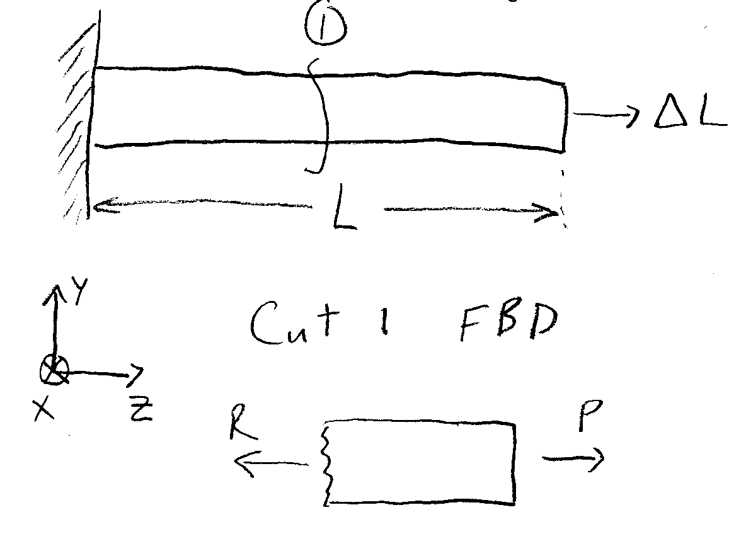
Uniaxial Tension (Analytical)
Beam strain of 2x10⁻⁴ applied
Calculated Max stress: 40 MPa
Figure 4: Uniaxial Tension FBD

Slide 6
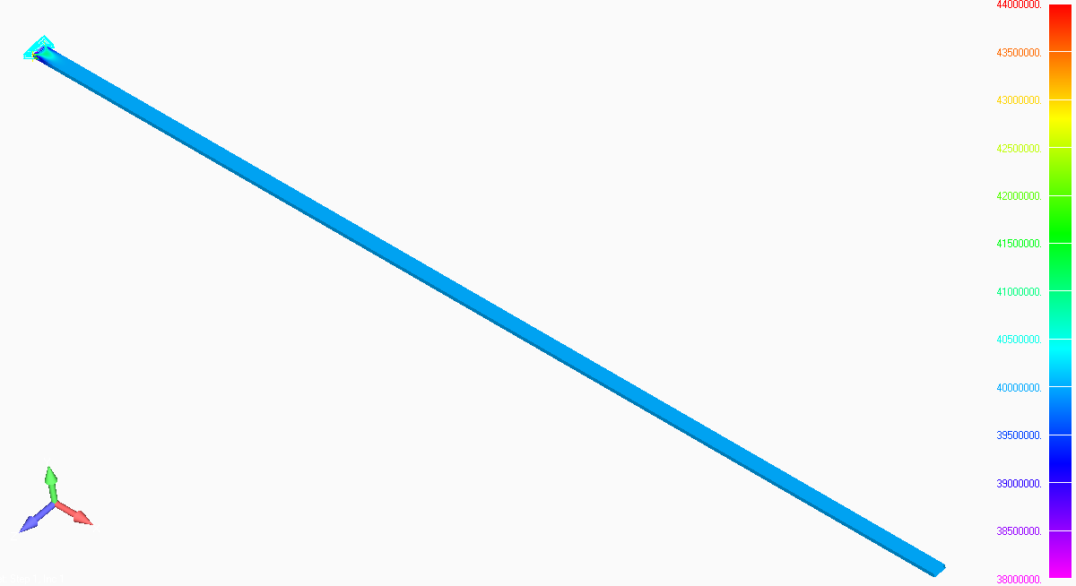
Uniaxial Tension (FEA)
-Contour: Plate Top X Normal Stress
-Deformation: Total Translation
-Deformed Style: Scale 10%
Figure 5: Deformed tension FEA model contour plot

Slide 7
Uniaxial FEA Output Data
Figure 6: Normal stress along beam length at midpoint element

Slide 8
Uniaxial Results Comparison
Analytical: σ = 40 Mpa
FEA: σ = 40.008 Mpa
Percent Difference: 0.020%

Slide 9
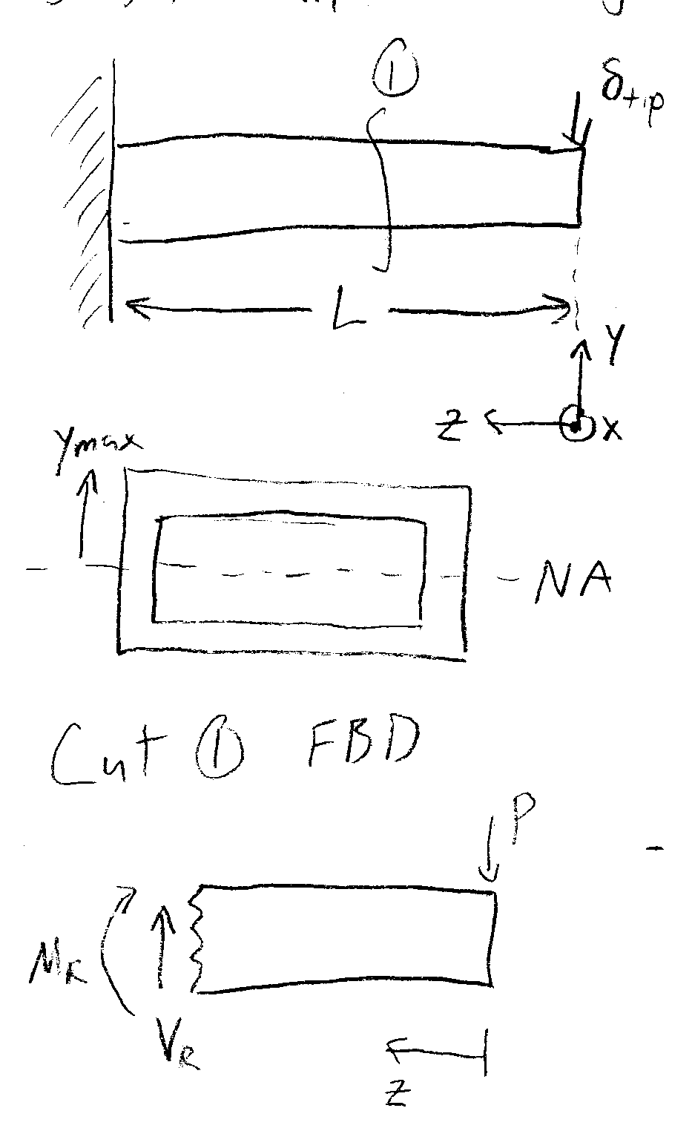
Bending (Analytical)
Tip deflection of 0.175 m applied downward
Calculated max stress: σ = 7.64 Mpa
Figure 7: Bending FBD

Slide 10
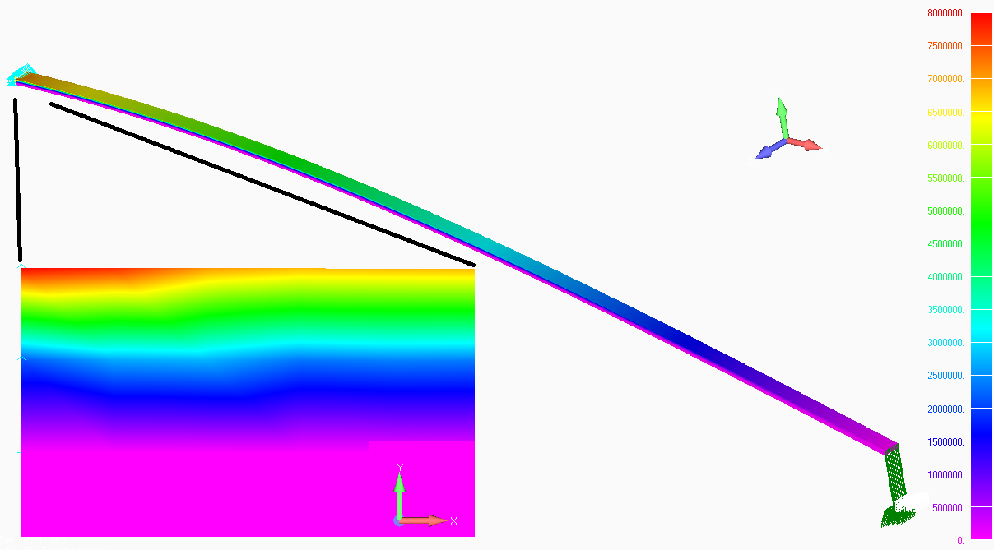
Bending (FEA)
-Contour: Plate Top X Normal Stress
-Deformation: Total Translation
-Deformed Style: Scale 10%
*NOTE: Minimum value of colored
legend chosen to reveal maximum
detail in mirror component above NA
Figure 8: Deformed bending FEA model contour plot

Slide 11
Bending FEA Output Data
Figure 9: Normal stress along beam length at midpoint element of top flange

Slide 12
Bending Results Comparison
Analytical: σ = 7.641 MPa
FEA: σ = 7.643 MPa
Percent Difference: 0.034%

Slide 13
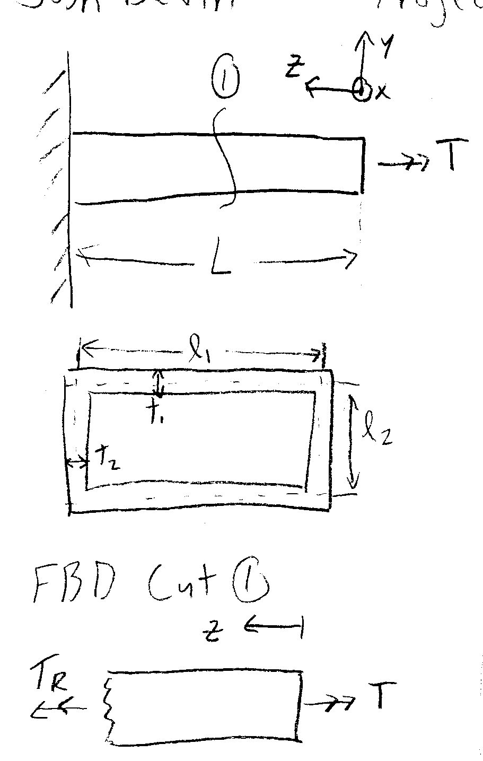
Torsion (Analytical)
Total tip rotation of 2° applied
Calculated max stress: τ = 11.80 Mpa
Figure 10: Torsion FBD

Slide 14
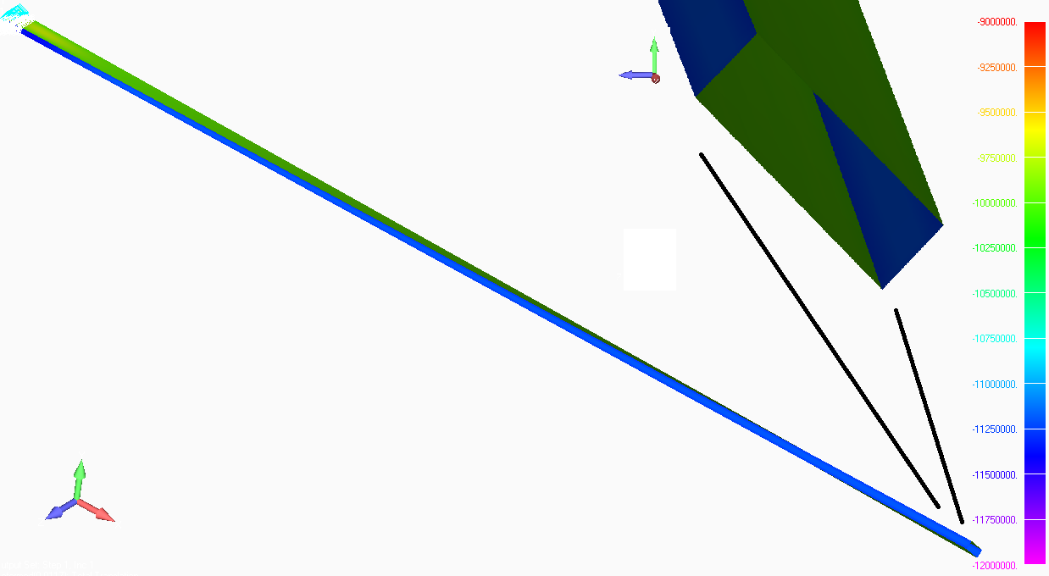
Torsion (FEA)
-Contour: Plate Top XY Shear Stress
-Deformation: Total Translation
-Deformed Style: Scale 0.5%
Figure 11: Deformed torsion FEA model contour plot

Slide 15
Torsion FEA Output Data
Figure 12: Shear stress along beam length at midpoint element of web

Slide 16
Torsion Results Comparison
Analytical: τ = 11.80 MPa
FEA: τ = 11.82 MPa
Percent Difference: 0.17%

Slide 17
Uniaxial Tension Discussion
FEA model had smooth and relatively constant normal stress throughout.
At the fixed end high local deformation caused stress in the area to spike ~2.5% higher than average stress.
Best fit line plotted through stress at elements along middle of flange to obtain average stress in beam, ignoring local discontinuous behavior at fixed end (Fig 6)

Slide 18
Bending Discussion
Normal stress changed smoothly along length of beam in FEA model, increasing as distance from tip deflection increased.
At the fixed end high local deformation caused stress in the area to spike ~1.3% higher than stress predicted by analytical solutions at that position.
Best fit line plotted through stress at elements along middle of top flange, ignoring local discontinuous behavior at fixed end. Best fit line than extrapolated past local distortion to determine “ideal” normal stress adjacent to the wall without the influence of local effects (Fig 9).

Slide 19
Torsion Discussion
Shear stress constant along beam length and member cross-sectional length in FEA model. Dependent only on thickness of plate element.
At the fixed end high local deformation caused stress in the area to spike ~6% higher than stress predicted by analytical solutions at that position.
Best fit line plotted through stress at elements along middle of thinnest plate, averaging top and bottom values for shear stress and averaging along length of beam in stable behavior region.

Slide 20
Observations
In all FEA models some local distortion was present near constrained end, but dissipated as the distance from the constraint increased.
All FEA models predicted slightly higher stresses than the analytical solutions.
Extremely long beam length to width or height ratio.

Slide 21
Method Agreement
 | Analytical (Mpa) | FEMAP (Mpa) | % Difference
Tension | 40 | 40.08 | 0.020 %
Bending | 7.641 | 7.643 | 0.034
Torsion | 11.80 | 11.82 | 0.17
Table 3: FEA and analytical max stress prediction agreement
In general there was excellent agreement between analytical solutions and the complementary FEA model; all percent differences were less than 0.2%
Torsional percent difference is an order of magnitude higher, likely due to use of several simplifying assumptions.

Slide 22
Discrepancies (Tension and Bending)
Discrepancies in FEA and analytical models for uniaxial tension likely due to localized narrowing of beam near fixed constraint where beam edge is unable to change shape
Bending differences may be a result of stress singularities where beam end elements (subject to greatest bending moments) join to fixed nodes.

Slide 23
Discrepancies (Torsion)
In torsional case there are several differences between the two methods.
Analytical solutions assume shear stress is constant across member thickness. FEA model attempts to calculate shear at both free surfaces of a plate member.
In order to force evaluation of shear stress at center of member thickness an average of the “Plate Top” and “Plate Bot” FEA shear stresses must be taken.
Still some error associated with averaging two extrema to approximate center evaluation; shear stress curve across thickness actually parabolic rather than linear.

Slide 24
Conclusion
FEA model built to evaluate maximum stress in a long, slender, hollow cantilever box beam under axial tension, bending, and twisting.
Analytical solutions also derived for the three loading cases.
Excellent agreement between the methods predicted results <0.2% in all cases.
Some limitations of agreement stem from local deformation near constraints in FEA model, while others result from simplying assumptions in analytical solutions.

